Slide 1
Stages of a Mid-Latitude Cyclone

Slide 2
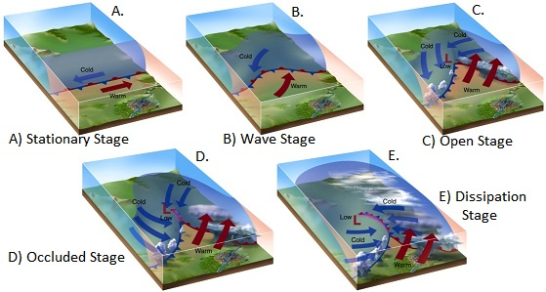
Evolution of a Mid-Latitude Cyclone
Mid-latitude cyclones generally go through a distinct set of stages, each associated with recognizable features, processes, and weather patterns.

Slide 3
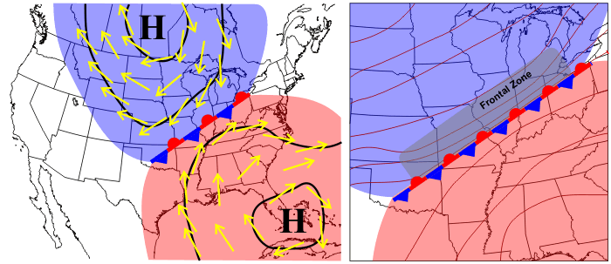
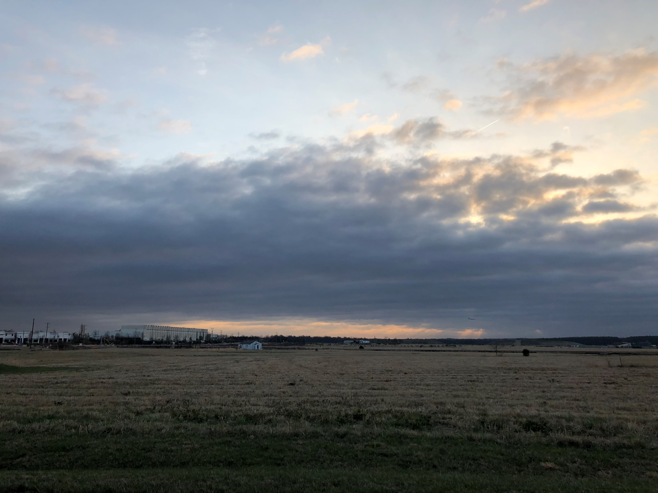
Stage 1: Stationary
A boundary separates the cold and warm air masses.

Slide 4
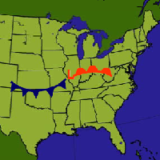
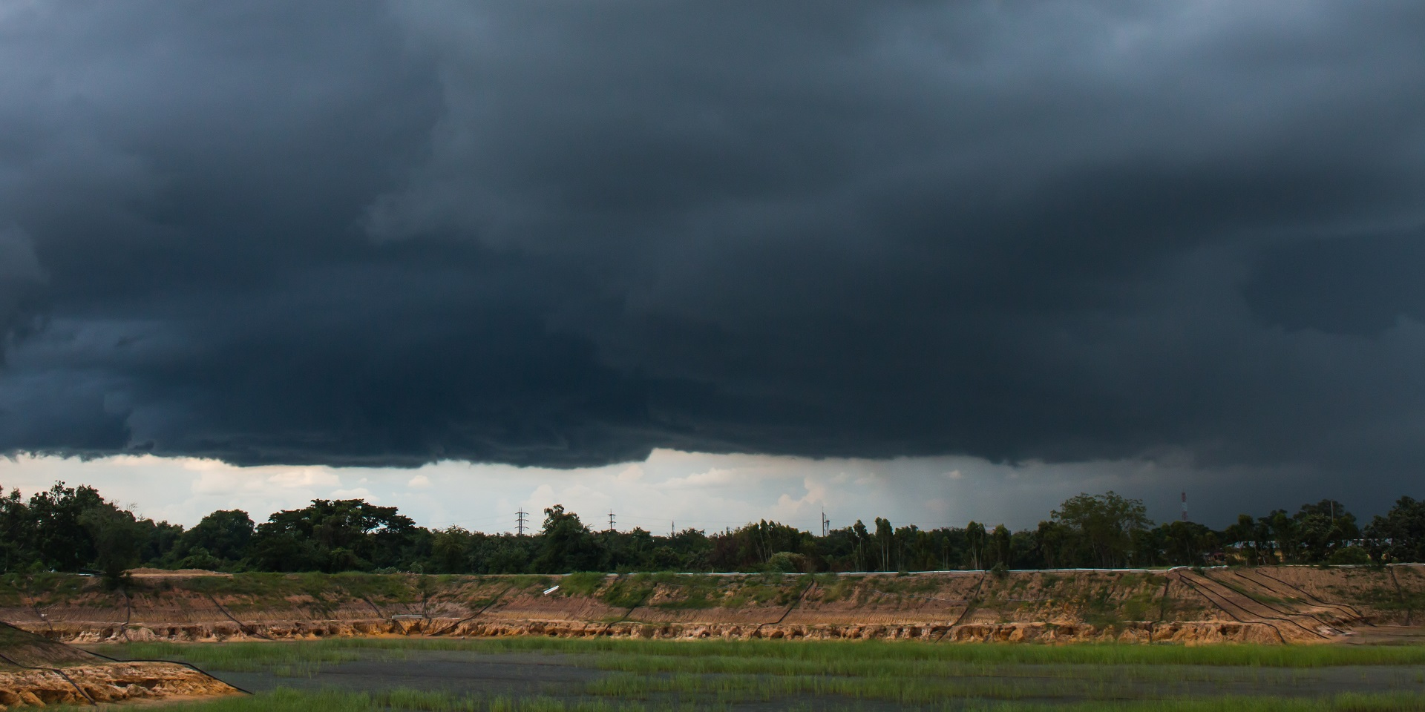
Stage 2: Initial Wave
An atmospheric disturbance generates wind shear (difference in wind speed or direction) along the front, causing a wave to form.

Slide 5
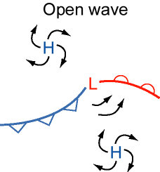
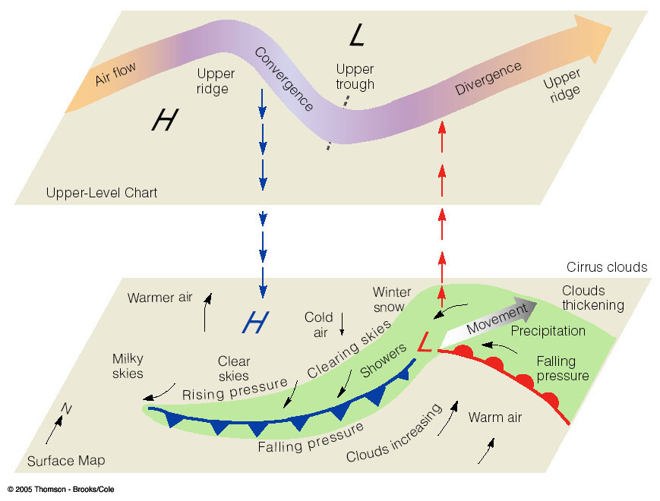
Stage 3: Advanced Wave
As the cold air mass begins to move into the warm air mass, the fronts begin to rotate around the low pressure center.

Slide 6
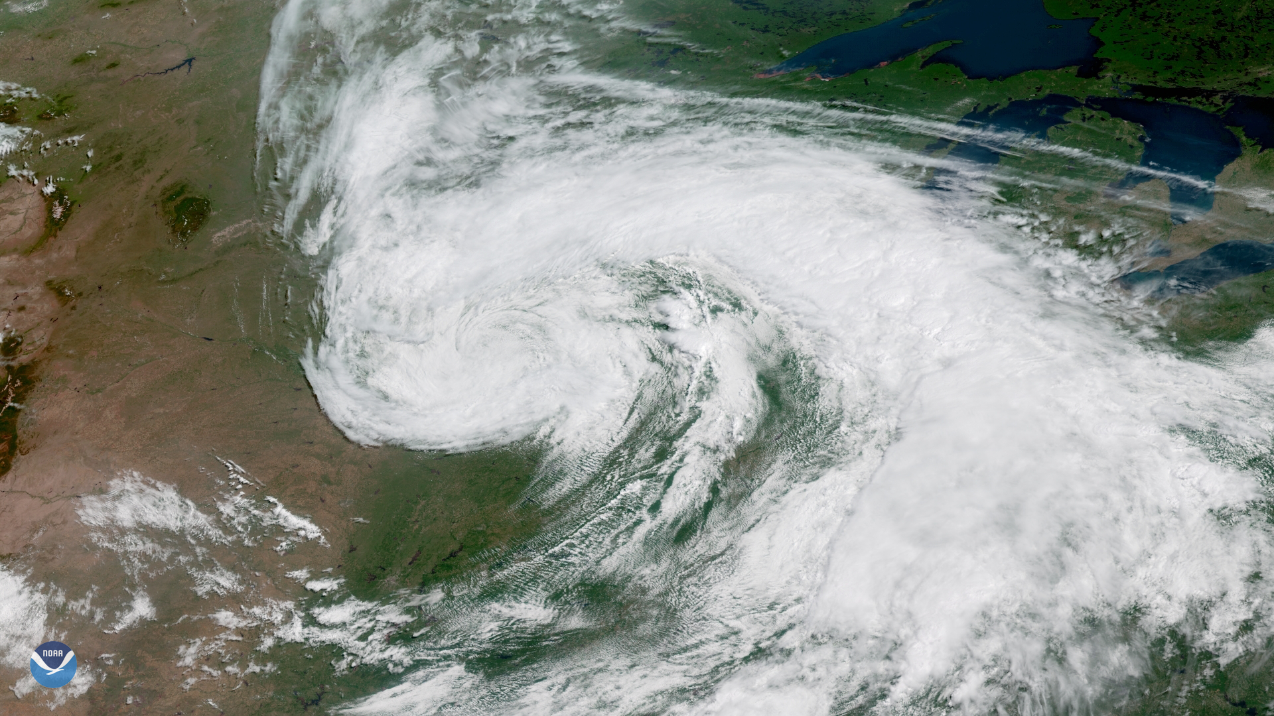
Stage 4: Mature
The cold front moves faster than the warm front, causing the cyclonic circulation to become stronger.

Slide 7
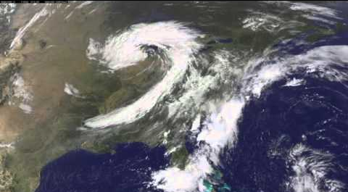
Stage 5: Occlusion
The cold front catches up to the warm front, at which point the fronts become “occluded” as the cold air slides underneath the warm air.
The wave now becomes a closed circulation, or loop.

Slide 8
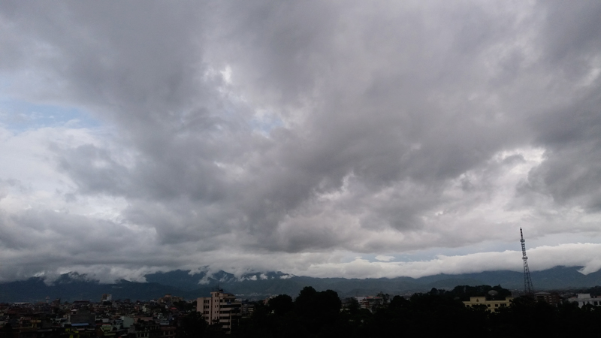
Stage 6: Dissipation (cutoff low)
The cold air has now wrapped around the low pressure, cutting off the flow of warm air.
The wave is now entirely replaced by a loop, and the low pressure system begins to “dissolve” as it mixes with the air around it.

